Slide 1

Outlines
Multiplexers (MUX)
  What are they?
  Design
  Function Implementation

Slide 2
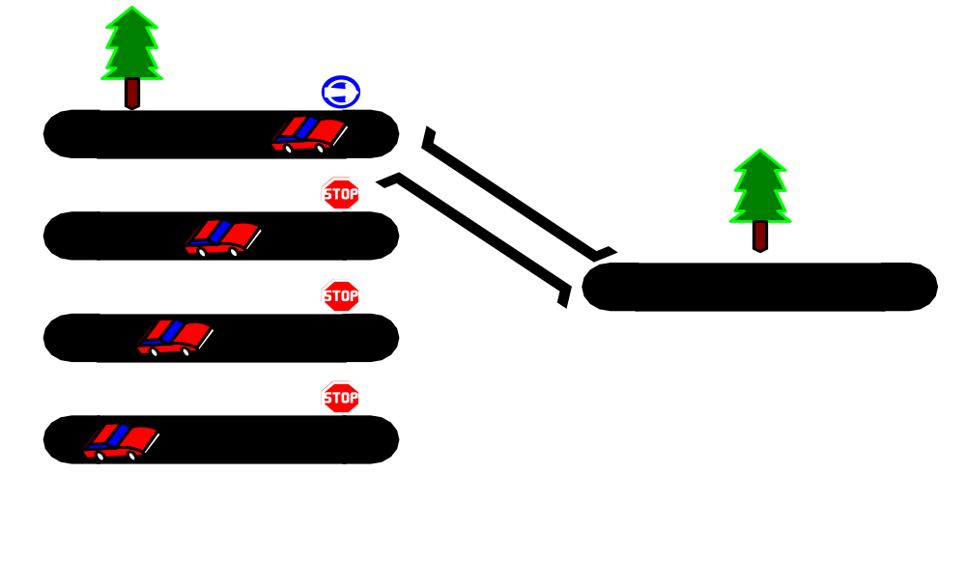
Multiplexers
Multiplexers (MUX)/ Data Selector
A comb. cct. that selects binary information from one of many I/p lines and directs it to a single O/p line

Slide 3
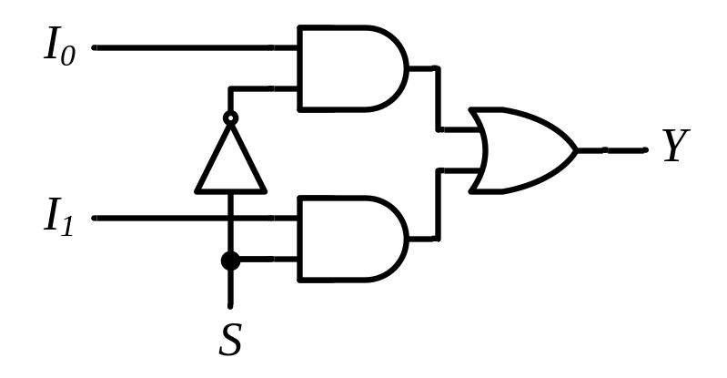
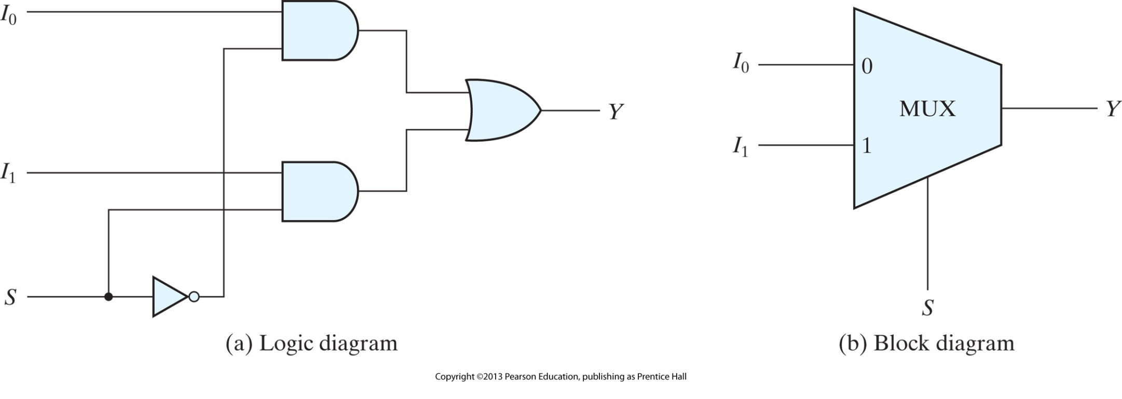
Two-to-one-line Multiplexer
Normally, there are 2^{n} I/p lines and n selection lines
MUX
I₀
I₁
Y
S

Slide 4
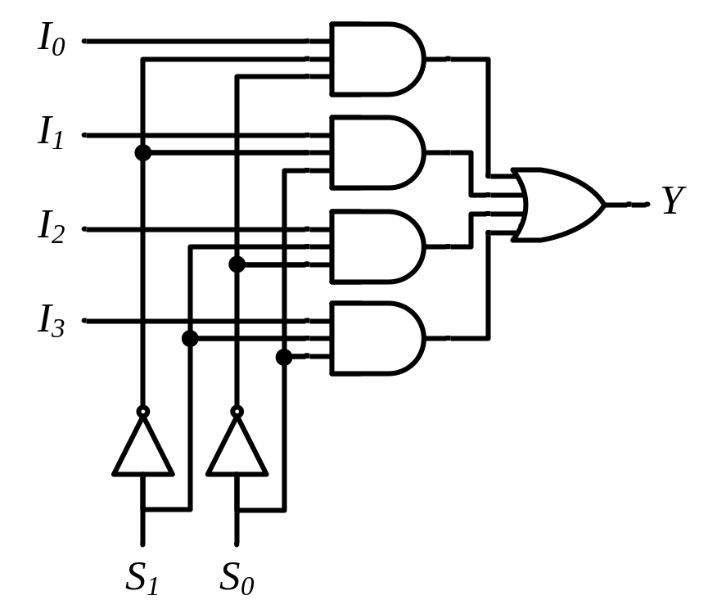
Four-to-one-line Multiplexer
MUX
I₀
I₁
I₂
I₃
Y
S₁ S₀
S₁ S₀ | Y
0 0 | I₀
0 1 | I₁
1 0 | I₂
1 1 | I₃

Slide 5
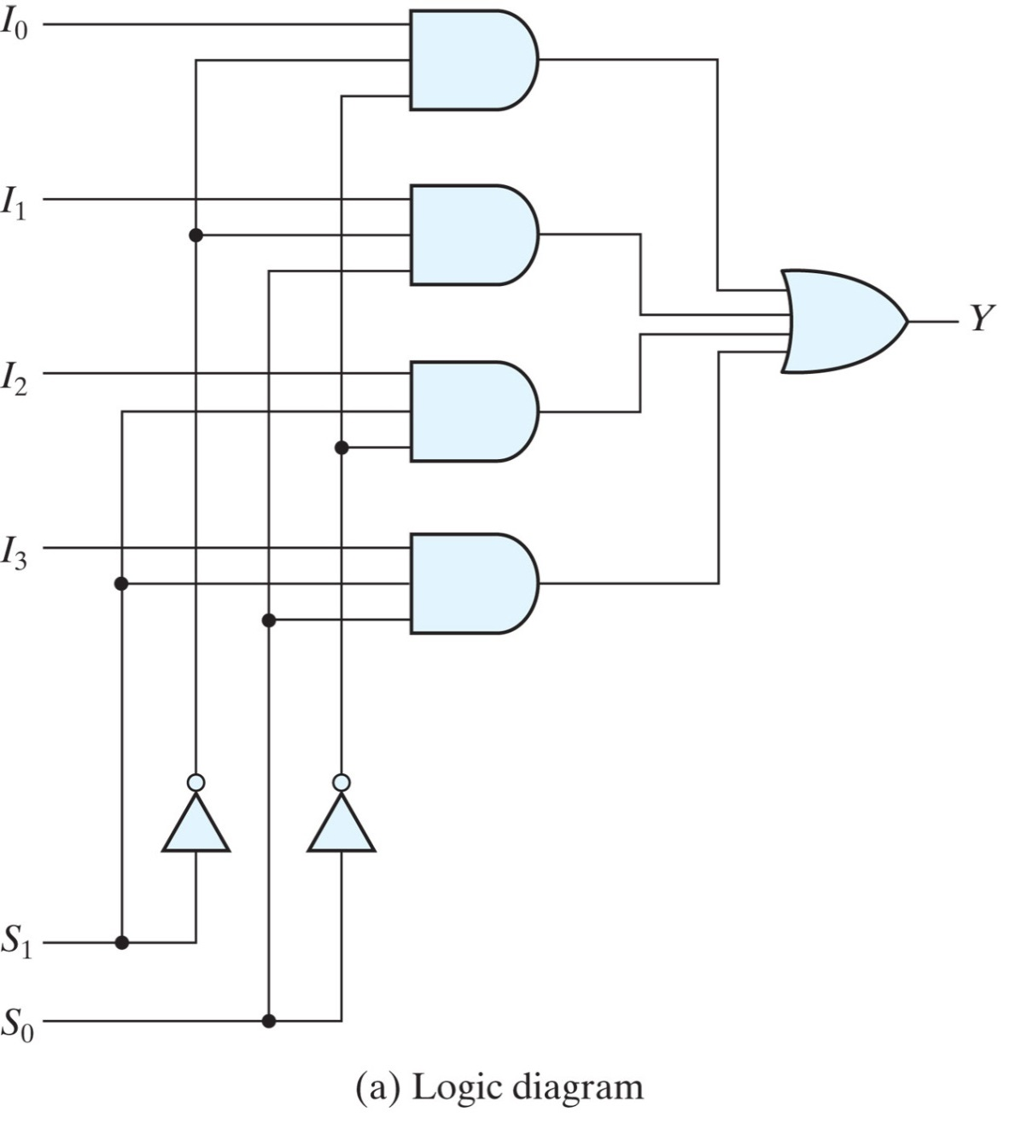
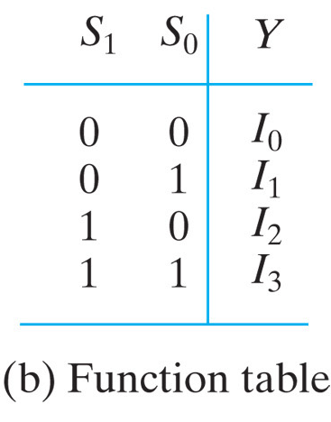
Four-to-one-line Multiplexer
S₁S₀ = 10, Y=?

Slide 6
Quadruple Two-to-one-line Multiplexer
Multiple-bit selection logic
A₃
A₂
A₁
A₀
MUX
I₀
I₁
B₃
B₂
B₁
B₀
Y
S
MUX
MUX
I₀
I₁
A₃
A₂
A₁
A₀
Y
S
Y₃
Y₂
Y₁
Y₀
MUX
I₀
I₁
B₃
B₂
B₁
B₀
Y
S
MUX
S E
I₀
I₁
Y
S
S

Slide 7
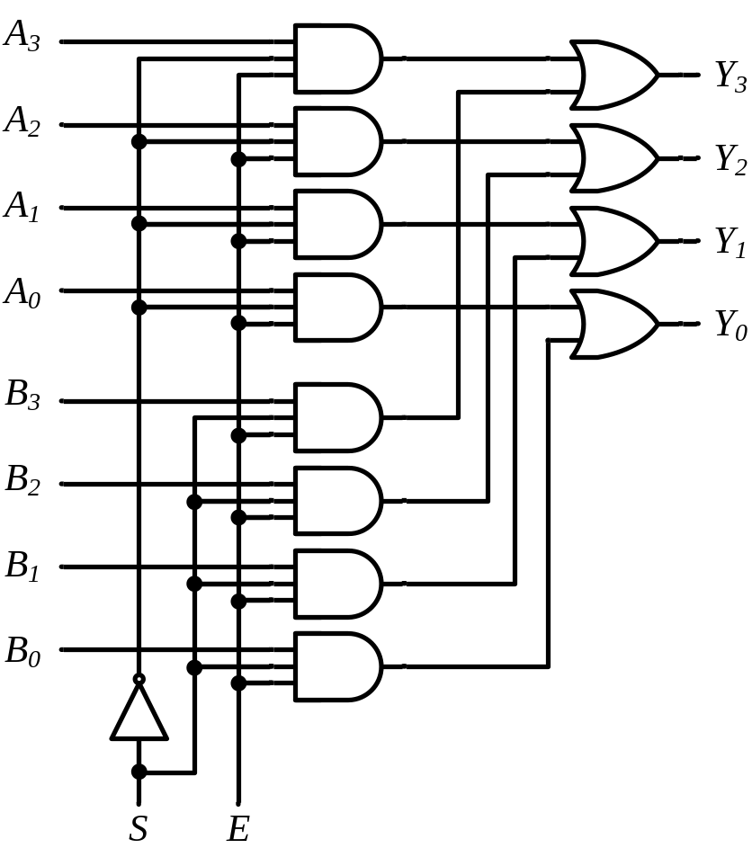
Quadruple Two-to-one-line Multiplexer
Multiple-bit selection logic
MUX
A₃
A₂
A₁
A₀
Y₃
Y₂
Y₁
Y₀
B₃
B₂
B₁
B₀
S E

Slide 8
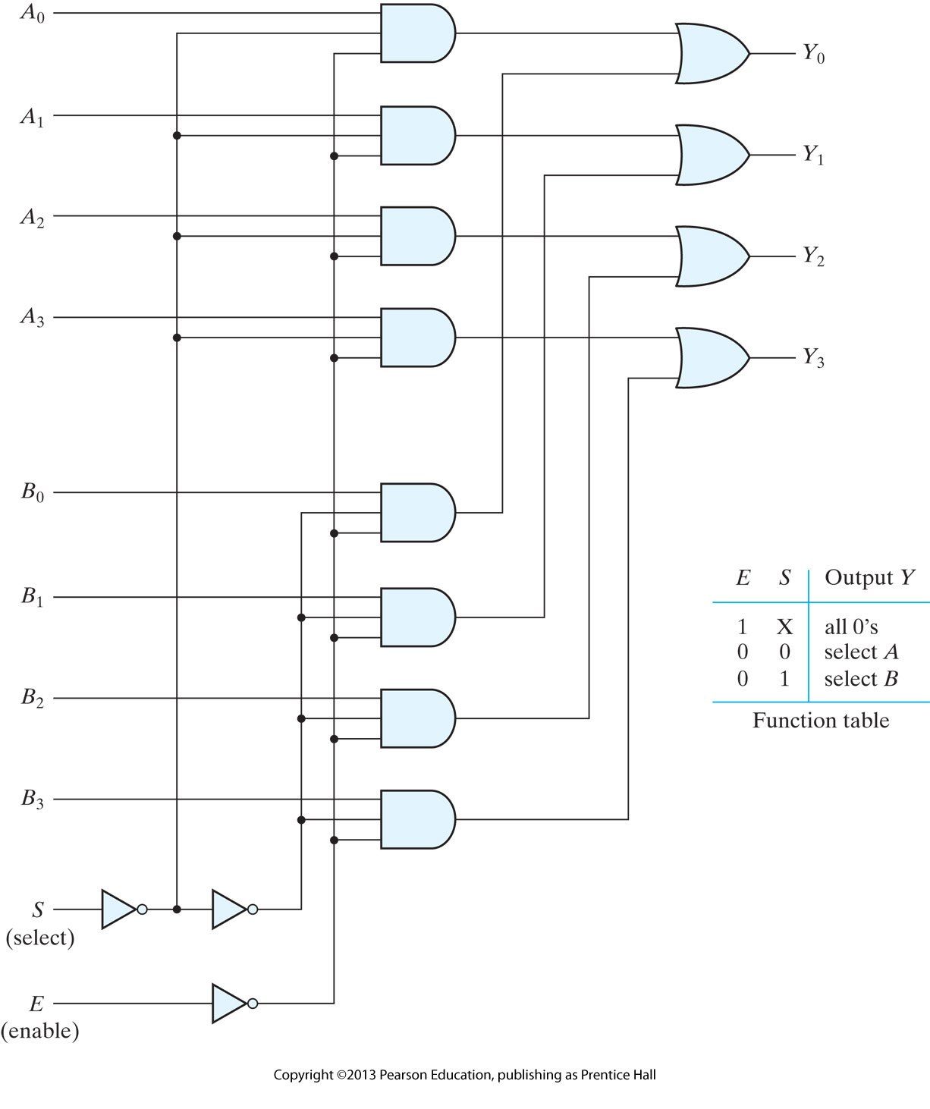
Quadruple Two-to-one-line Multiplexer
Table?

Slide 9
Boolean Function Implementation
Example
F(x, y) = ∑(0, 1, 3)
x y | F
0 0 | 1
0 1 | 1
1 0 | 0
1 1 | 1
MUX
1
1
0
1
I₀
I₁
I₂
I₃
Y
F
S₁ S₀
x y

Slide 10
Boolean Function Implementation
Example
F(x, y, z) = ∑(1, 2, 6, 7)
MUX
0
1
1
0
0
0
1
1
I₀
I₁
I₂
I₃ I₄
I₅
I₆
I₇
x y z | F
0 0 0 | 0
0 0 1 | 1
0 1 0 | 1
0 1 1 | 0
1 0 0 | 0
1 0 1 | 0
1 1 0 | 1
1 1 1 | 1
F
F
S₂ S₁ S₀
x y z

Slide 11
Boolean Function Implementation
Solution
F(x, y, z) = ∑(1, 2, 6, 7)
x y z | F
0 0 0 | 0
0 0 1 | 1
0 1 0 | 1
0 1 1 | 0
1 0 0 | 0
1 0 1 | 0
1 1 0 | 1
1 1 1 | 1
F = z
z
MUX
I₀
I₁
I₂
I₃
z
F
F = z
Y
0
1
F = 0
S₁ S₀
x y
F = 1

Slide 12
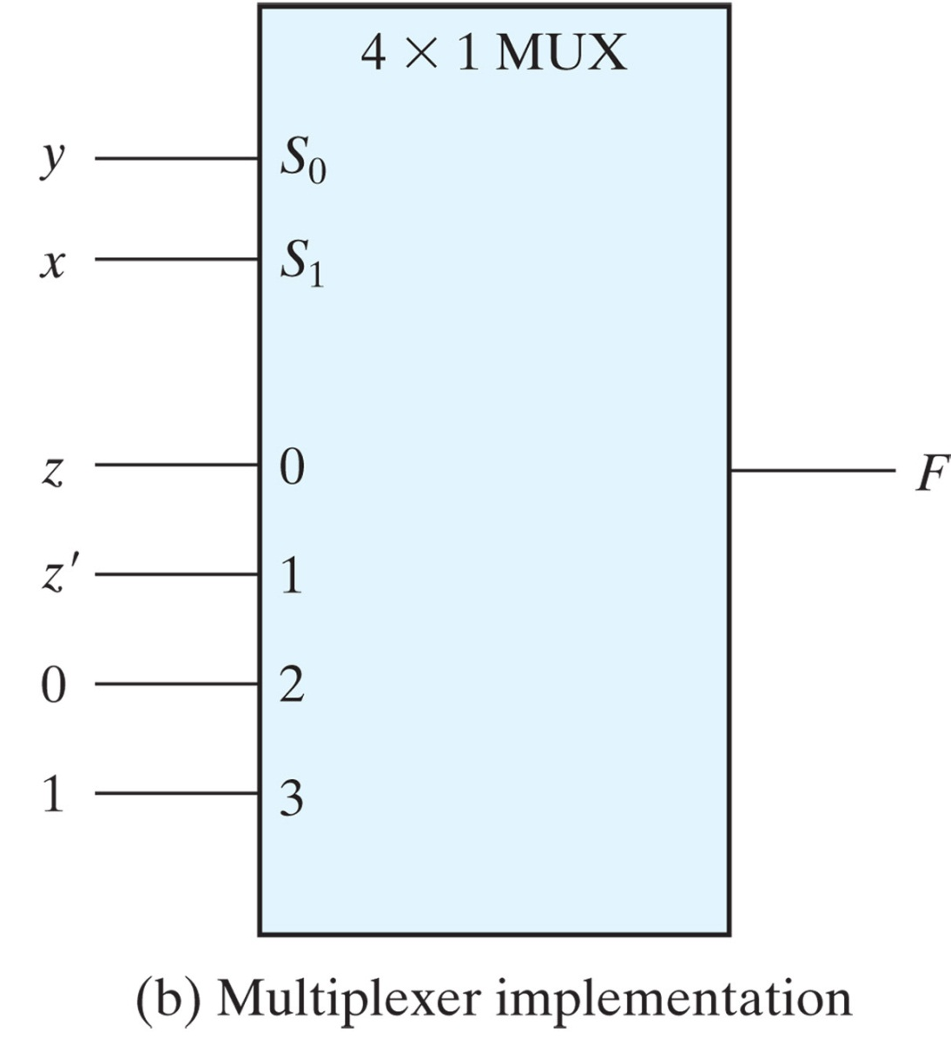
Boolean Function Implementation
Solution
z
MUX
I₀
I₁
I₂
I₃
z
F
0
Y
1
S₁ S₀
x y

Slide 13
Boolean Function Implementation
Example
F(A, B, C, D) = ∑(1, 3, 4, 11, 12, 13, 14, 15)
A B C D | F
0 0 0 0 | 0
0 0 0 1 | 1
0 0 1 0 | 0
0 0 1 1 | 1
0 1 0 0 | 1
0 1 0 1 | 0
0 1 1 0 | 0
0 1 1 1 | 0
1 0 0 0 | 0
1 0 0 1 | 0
1 0 1 0 | 0
1 0 1 1 | 1
1 1 0 0 | 1
1 1 0 1 | 1
1 1 1 0 | 1
1 1 1 1 | 1
MUX
D
I₀
I₁
I₂
I₃ I₄
I₅
I₆
I₇
F = D
D
F = D
D
F = D
0
Y
F
0
F = 0
D
F = 0
1
F = D
1
S₂ S₁ S₀
F = 1
F = 1
A B C

Slide 14
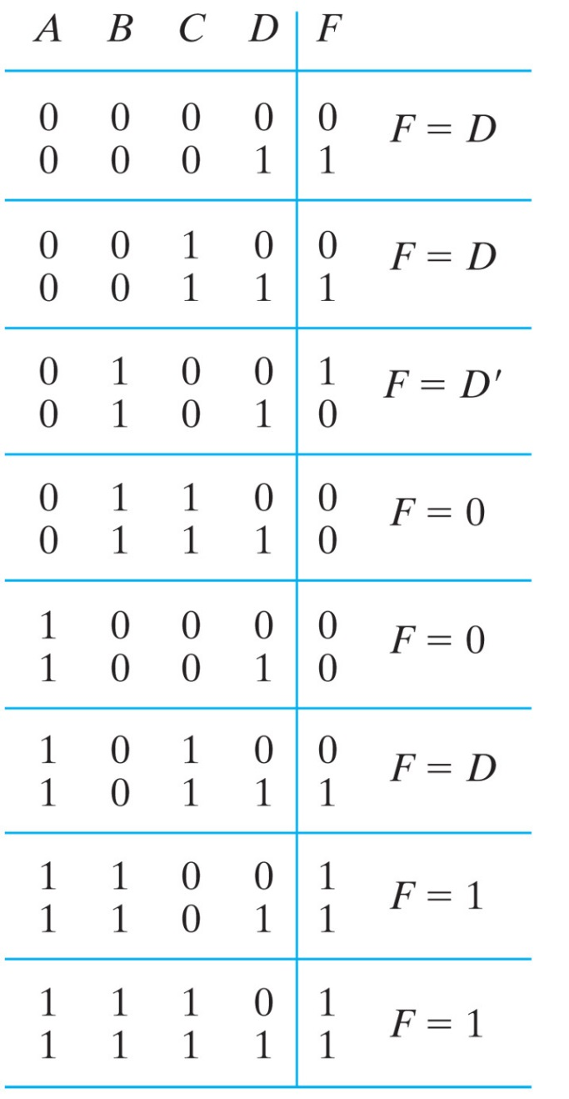
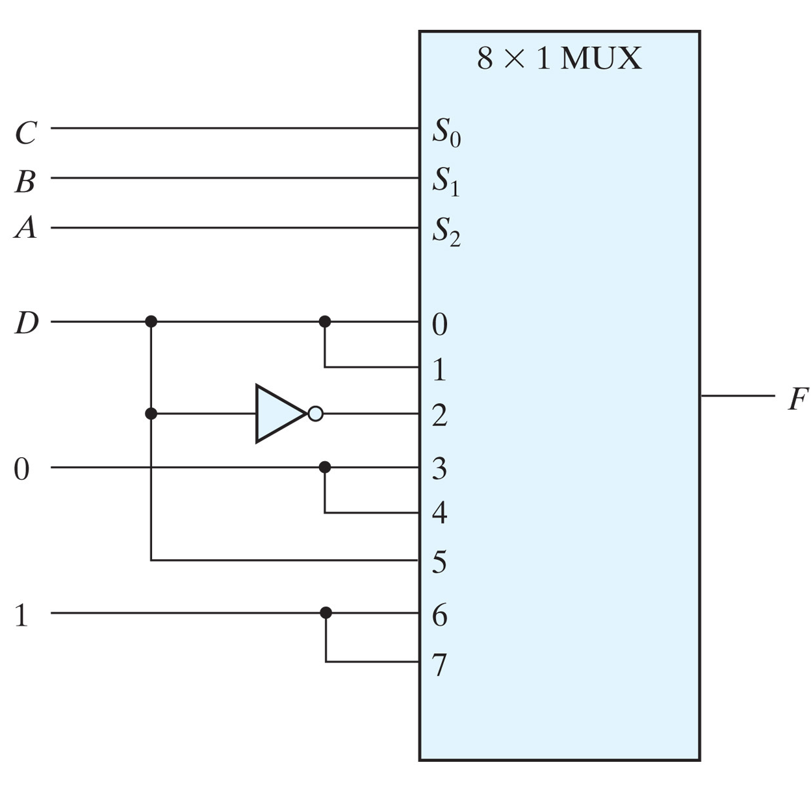
Boolean Function Implementation
Solution

Slide 15
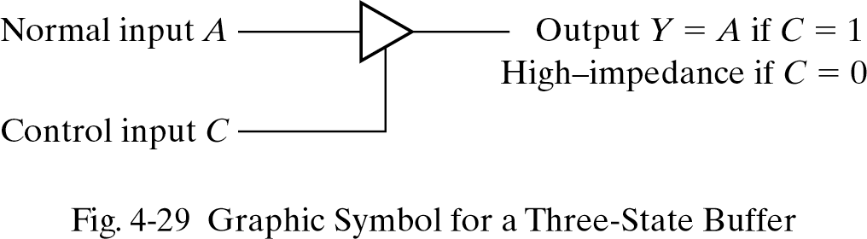
Three State Gates
Two state gates have two possible outputs ‘0’or ‘1’
Three state gates have three possible outputs: ‘0’, ‘1’ and high impedance (open circuit).
Any logical gate can be designed with three state gates.

Slide 16
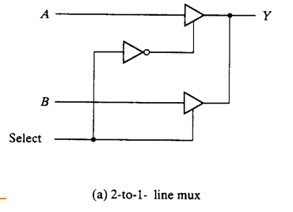
Three-state gates
  A multiplexer can be constructed with three-state gates

